Slide 1
What are your Strengths?

Slide 2
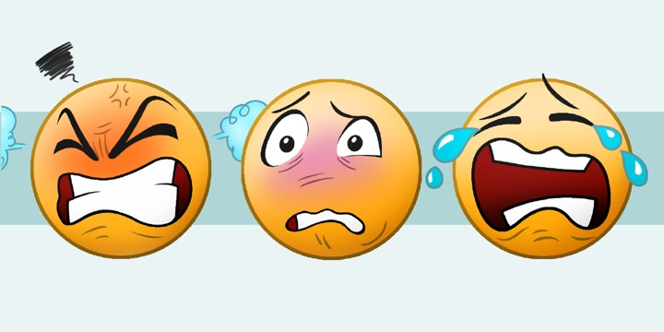
When we face hardships we often respond with one of the following emotions:
anger
anxiety
sadness/depression
Notes:
We experience all 3, often one emotion is more prominent than the others
You could share examples of situations that could evoke emotions. (i.e. Doing poorly on a test/Not getting the position you want for a team or a role in a play/A sibling getting upset with you/etc.) Get students thinking about everyday/realistic scenarios and what emotions come up.
- you can share too! It’s a good way to show that EVERYONE reacts someway to these issues. You know your Titan Team so you can guide this how you see fit to get them thinking/discussing these scenarios.
- our goal here is to acknowledge these emotions and focus more time on the strengths that we rely on to get through them

Slide 3
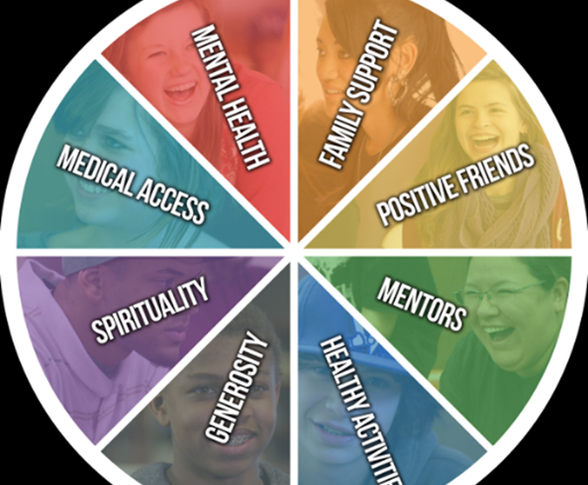
Sources of Strength:
- a program that opens us up to healthy ways to deal with these emotions
Notes:
We should all find some ways to help us through those tough times and the wheel here shows different STRENGTHS.
- STRENGTHS are things we have around us to help us process and move forward
Take a moment to go around and explain what each slice is or give examples. Spirituality and Generosity, can be tough to give examples of so there are definitions here
- Generosity: doing things for others and giving of our own time, which can lift our spirits and others’
- Spirituality: practicing gratitude, mindfulness, and connectedness with a larger purpose

Slide 4
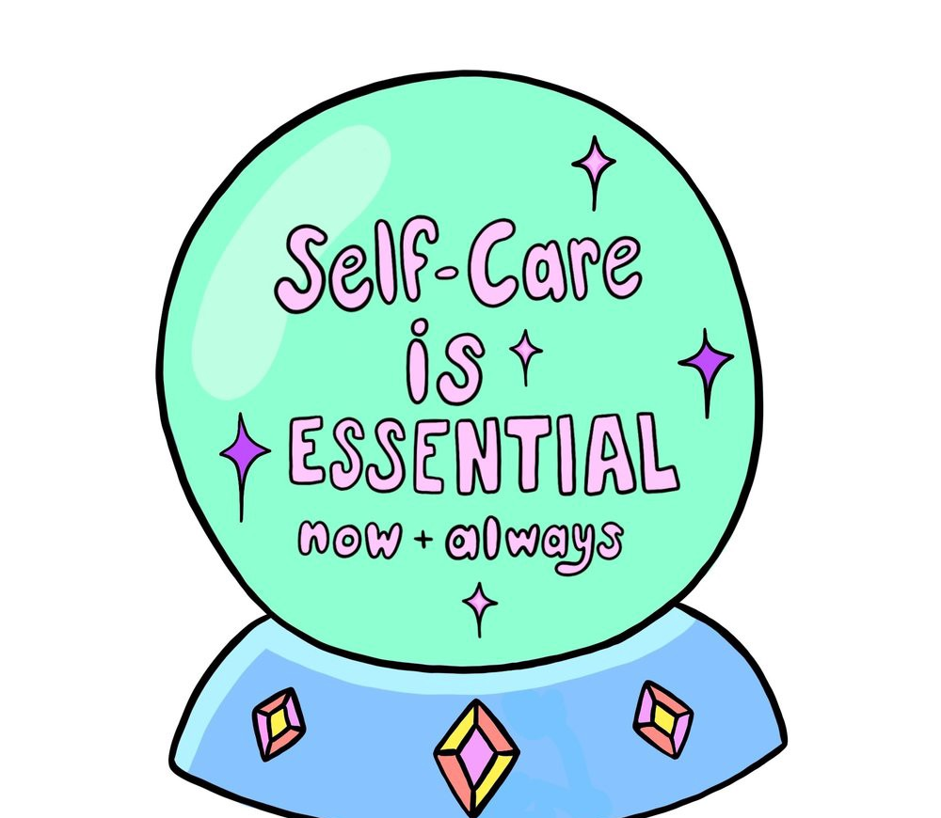
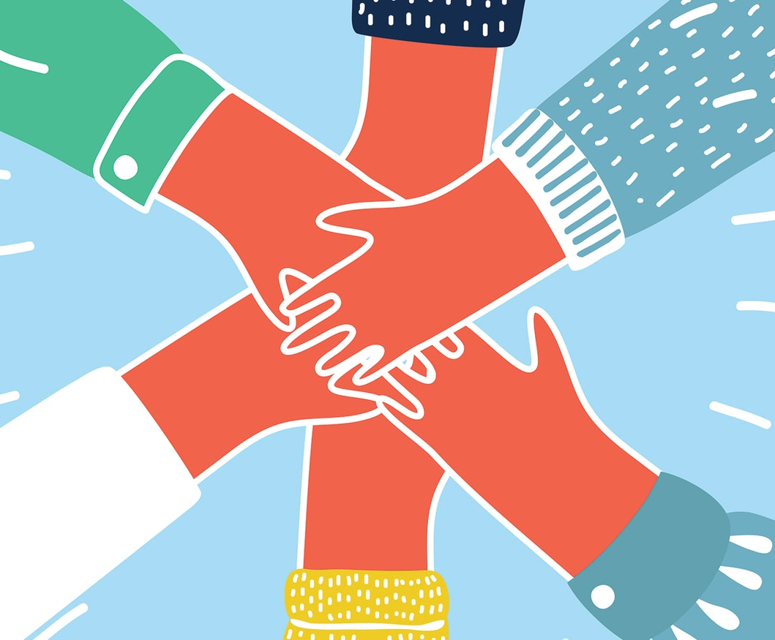
What helps you through these emotions?
Notes:
Let’s discuss some examples!
Some students may have multiple, and some may have a tough time recognizing theirs. Be patient, give ideas!
Note that most examples can fit under one of the slices of the wheel. i.e. I turn to music or run when I’m angry (healthy activities). I talk to my best friend or uncle or counselor when I’m anxious (positive friend/family support/ mentor). After suffering a sports injury I saw a doctor/counselor when healing and moving forward (mental and medical health)

Slide 5
Write down the following sentence:
When I feel _______________ ,
I turn to _________________ .
Notes:
When I feel (insert one of the 3 emotions), I turn to (a strength).
You could have students share their strengths here if they are comfortable, or have them write the above phrase.
Get them thinking about what sources of strength they have.
- encourage students to be descriptive
- you could have the students write out a few strengths while they watch the video, keeping in mind what emotion they often deal with
If this video does not work, you can follow the link here: https://www.youtube.com/watch?v=81EB9rhwhVw

Slide 6
We are TITAN STRONG

